Slide 1

TECH REVIEW
Andrew Wildman, Ian Murphy, Lauren Koulias, Torin Stetina

Slide 2
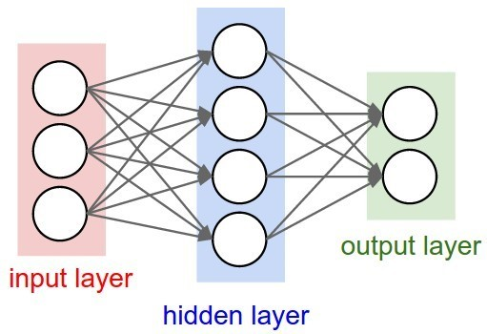
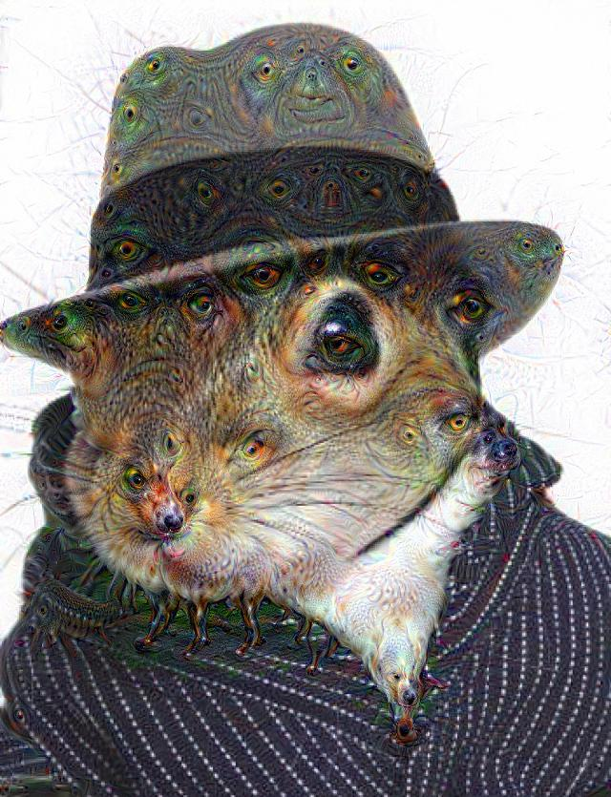
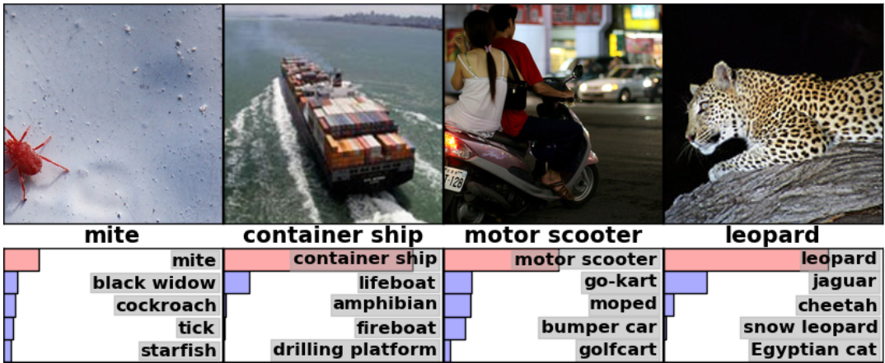
Background – What are neural nets?

Slide 3

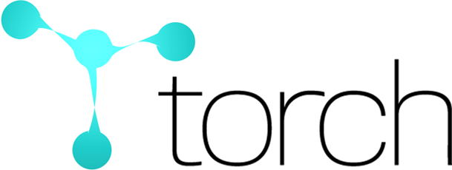





Background – Deep Learning Libraries

Slide 4

Background – How are they used?
Formulate problem in ML framework
Decide on appropriate architecture
Build NN architecture
Train
Predict

Slide 5

Appeal
“Deep learning for humans”
Unified API for multiple backends
Enormous community support
Pre-built network architectures
SIMPLICITY

Slide 6
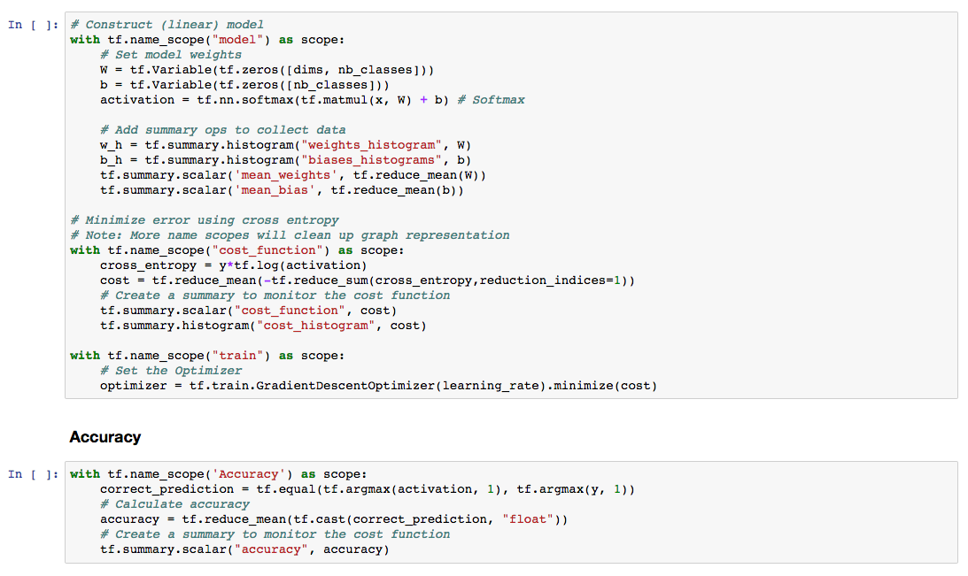
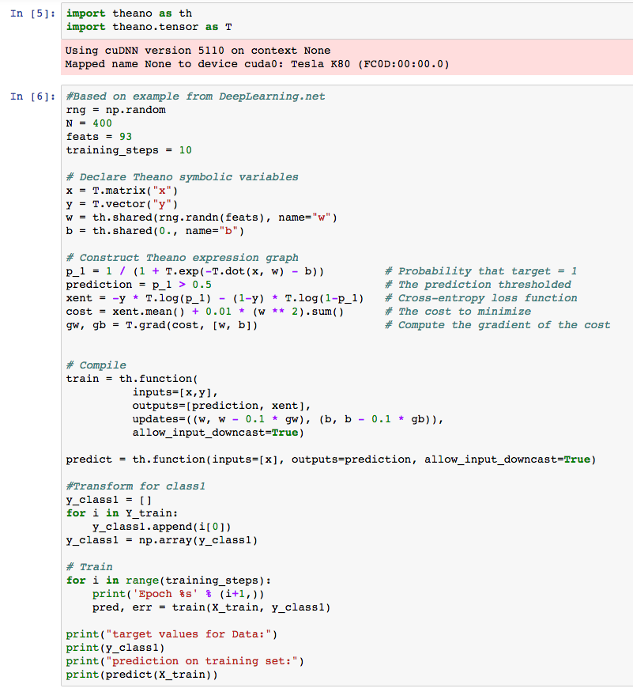
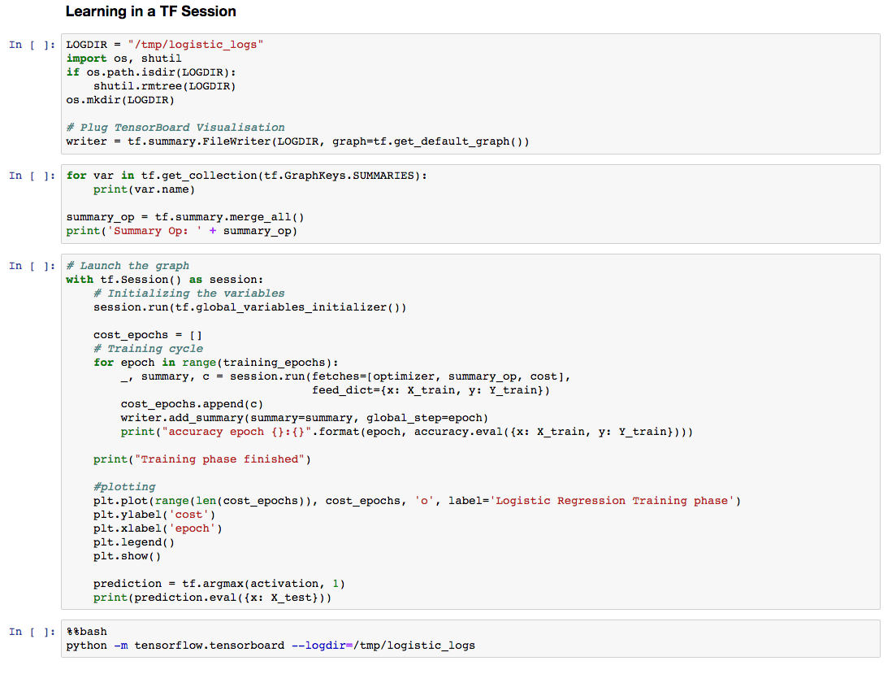
Logistic Regression

Slide 7
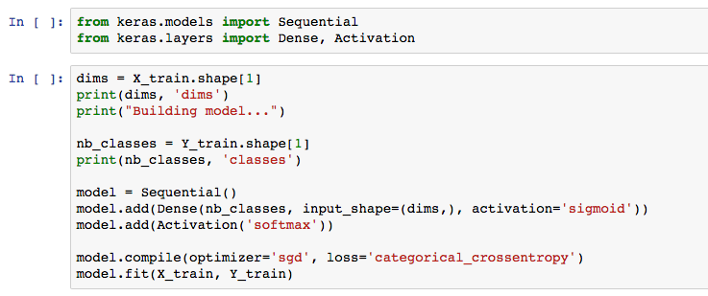
Logistic Regression

Slide 9
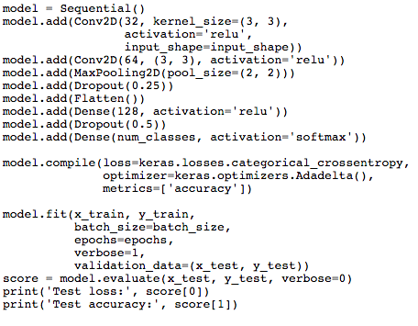
How it works
Convolutional NN Model
Specify model
Add layers
Purely a front end
Provides common architectures and node structures
Assemble model
Train model
Test model

Slide 10
Drawbacks
MPI

Slide 11
Drawbacks
MPI
Poor scalability on distributed systems (MPI)
Functionality limited by what the backend provides
Changing low-level portions of the architecture is
more difficult than using the backend itself
(Message Passing Interface)

